Slide 1
Power Apps CICD with GitHub Actions gregroe/powerapps-cicd-github-actions Greg Roe App Innovation Cloud Solution Architect Microsoft Federal gregroe@microsoft.com
What Problem are we trying to solve? What is the Value?
Solution Architecture
Workflows
Dev-Build-Test
Release to Production

Slide 2
What Problem does the solution solve? What is the value?
Problem:
Your organization wants to leverage source control and CICD for your Power Platform Solution workloads. You’d like to have a Dev-Test-Prod Application Lifecycle Management process.
Solution:
This reusable solution uses GitHub Actions Workflows to automate pushing your Power Apps Solutions into Source Control, and providing a CICD workflow from Dev-Build-Test-Prod. The solution leverages common Git concepts such as Source Control Repo,Pull Requests, Working branches, and Releases.
When you've tested, you create a pull request to push code changes from a development branch to the Main branch (golden version). Then when you want to push to production you create a "Release" and the latest source in Main is pushed to Production

Slide 3
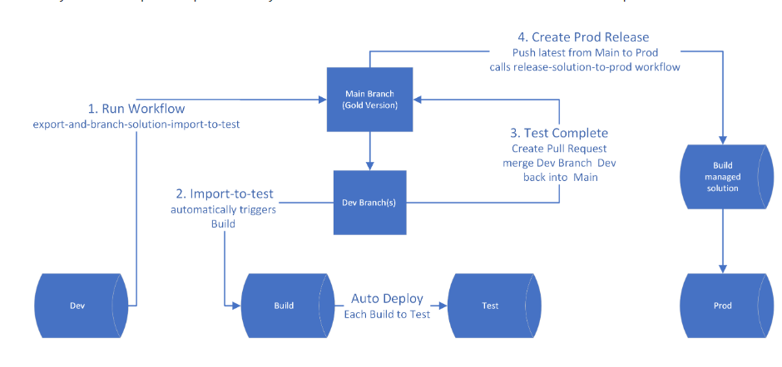
Solution Architecture

Slide 4
Dev-Build-Test Process (1-2-3)
runs export-and-branch-solution-import-to-test Action
calls import-to-test Action
Automates deployment from Dev-Build-Test-Prod using a pull requests and releases
Exports your Power Apps Solution from your Development dataverse Environment, creats a dev branch based off of Main. Checks unpacked solution in to dev branch
Imports a managed copy of your solution to Test
uses a build server to build managed solutions
uses the pull request process to check the tested dev branch solution back into the Main Source Branch.

Slide 5
Release to Prod Process (4)
Create a release
Calles release-solution-to-prod Action
builds a managed solution based on latest source in MAIN
Deploys to Production

Slide 6
Deployment
Fork gregroe/powerapps-cicd-github-actions
See Deployment Instructions
Deployment Instructions (high level):
Create Dev,Test,Build, Prod Dataverse Environments
Create a Service Principal App registration
Add Service Principal to each Dataverse Environment as App User
Create the following Github Environment Variable and Secrets:
Github Secret for the client-secret "PowerPlatformSPN“
BUILD_ENVIRONMENT_URL
CLIENT_ID
DEFAULTSOLUTION
DEVENVURL
PRODUCTION_ENVIRONMENT__URL
TENANT_ID
TEST_ENVIRONMENT_URL

